Slide 1
Introduction
SURP 2022 Python Bootcamp
Ohio State Astronomy
Slides by: James W. Johnson

Slide 2
Hello!
Fifth/Sixth year PhD student in the Astronomy Department
Research Interests
Galactic chemical evolution (David Weinberg, Jennifer Johnson)
[Type Ia] Supernovae (Chris Kochanek, Kris Stanek)
Previously: dark matter halos and their environments
Versatile Integrator for Chemical Evolution (VICE: https://pypi.org/project/vice)
~89,200 lines (Python & C) in latest release (1.3.0) supporting Python >= 3.6.
We’ll do a mix of slides and exercises – I won’t be collecting and grading anything. This isn’t a course. What you get out of this will reflect what you put into it.

Slide 3
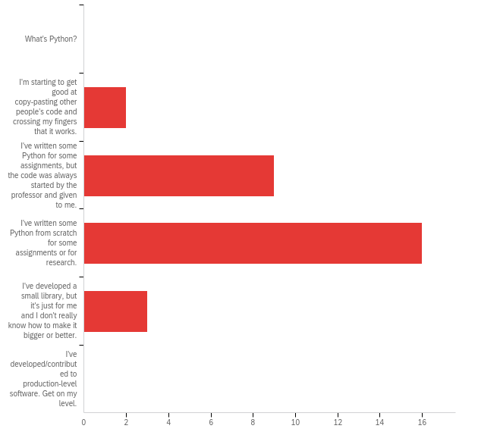
Survey Responses
Q1: How would you describe your skill level in Python?
A wide range of skills – some quite new, some have made small libraries
We’re aiming to get you up to the second-to-last option
Notes:
About current capabilities in Python, general census is most, if not all of you, have coded before. You’ve written code for class or research.

Slide 4
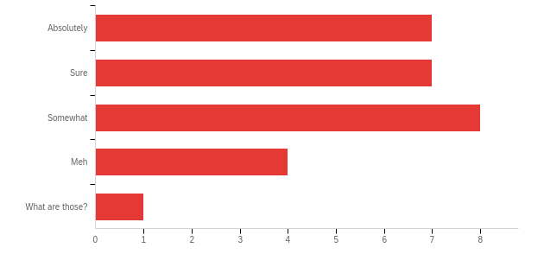
Survey Responses
Q2: Are you comfortable with if/else conditions, for- and while-loops, and def statements?
A wide range of skills in functional programming
Notes:
It seems like most of you are at least somewhat familiar with some of the basics of Python coding statements/practices.

Slide 5
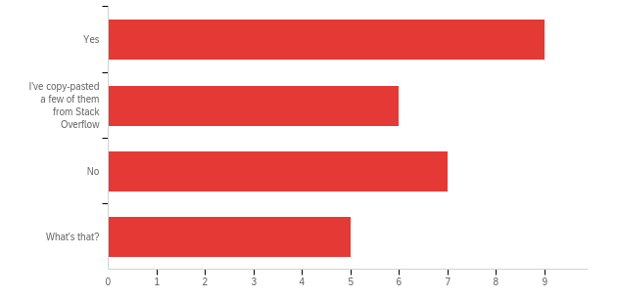
Survey Responses
Q3: Have you ever written a class?
Many of you have, many of you haven’t
This will be the focus of sessions 4 and 5
Notes:
About half and half when it comes to classes, and we mean classes as part of object-oriented programming and not actual courses on Python. We will discuss this more in later sessions so if you’re part of the ‘what’s that’ category, don’t worry!

Slide 6
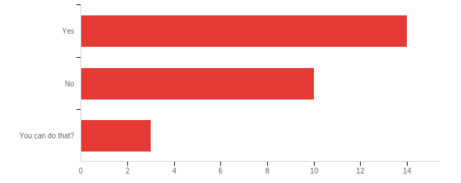
Survey Responses
Q4: Do you know how to, or have you already imported your own code from another file?
Many of you have, many of you haven’t
Notes:
Again, about half and half on this response. This is about using code that is not currently in the file you’re working in. Essentially you can use import statements to utilize other people’s code without having to write out this extra code yourself. We’ll definitely be covering this in later sessions.

Slide 7
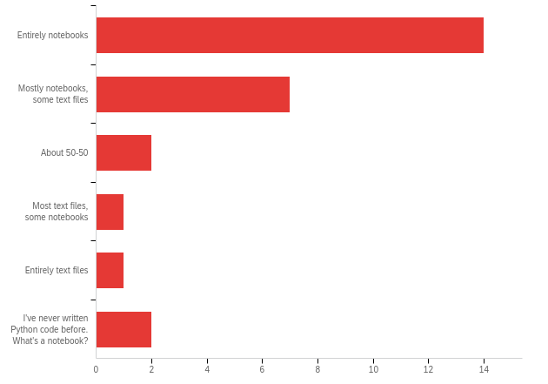
Survey Responses
Q5: Do you write code in text files or jupyter notebooks (or some equivalent)?
A wide range of preferences for your programming medium. Those who have received code from instructors probably ran it on SciServer, which uses notebooks
Notes:
So it looks like the majority of people have written code entirely in notebooks while some have experience using text files or text editor to write code instead. Notebooks and text editors are just applications where you can write and run code, essentially mediums for Python to run in. Notebooks themselves are nice because you can run small chunks of code one at a time and really get to the bottom of errors at an almost line by line level if you so choose. If you’ve received code in the past from professors for coursework, it’s most likely ran through a website called SciServer which uses notebooks.

Slide 8
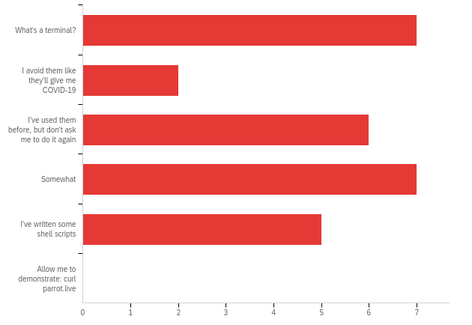
Survey Responses
Q6: How comfortable are you using a terminal/command-line?
Some of you have never used them, others are rather experienced
Notes:
So again, about half and half of you know what a terminal/command-line is and are comfortable with it while the other half of you are not. That’s okay! We will be covering this portion in today’s session and hopefully by the end of it, we can at least get you guys to the I’ve used them before category.

Slide 9
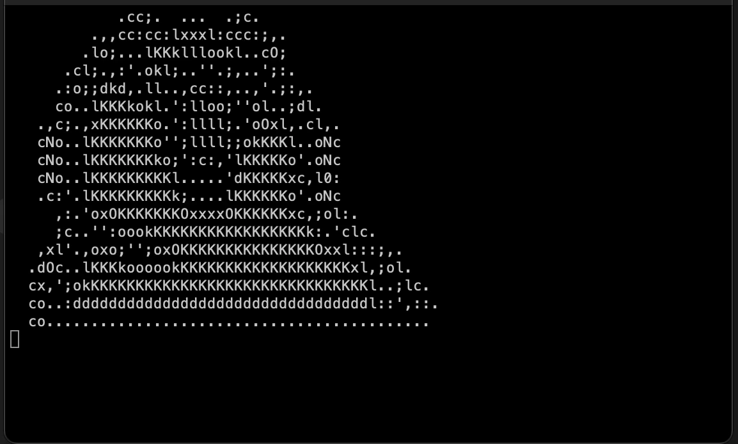
Survey Responses
Q6: How comfortable are you using a terminal/command-line?
Some of you have never used them, others are rather experienced

Slide 10
Survey Responses
New material:
For many of you: the terminal
For about half of you:
How to import your own code from elsewhere in your computer (packaging may be new to some)
Object oriented programming (some of the material may still be new)
Some of the material is either impossible or quite difficult when coding in a notebook. I advise all of you to use this bootcamp as practice for working in text files.
A few of you are students from last year’s SURP program who have already gone through this bootcamp – come talk to me if you’d like to go beyond this material!
Notes:
In particular, if there are students who successfully implemented the deck of cards last year and are still comfortable with this level of programming, they should talk to me after this session. In short, the best thing they can do is pick up some knowledge of a compiled language. I would recommend C or C++.

Slide 11
Survey Responses
New material:
For many of you: the terminal
For about half of you:
How to import your own code from elsewhere in your computer (packaging may be new to some)
Object oriented programming (some of the material may still be new)
Some of the material is either impossible or quite difficult when coding in a notebook. I advise all of you to use this bootcamp as practice for working in text files.
Those of you new to Python – Wednesday is going to be a crash course. I’d strongly advise going through some of the additional beginner-level material linked on GitHub
Notes:
I’ll show them how to download the course material after we talk about terminal commands.

Slide 12
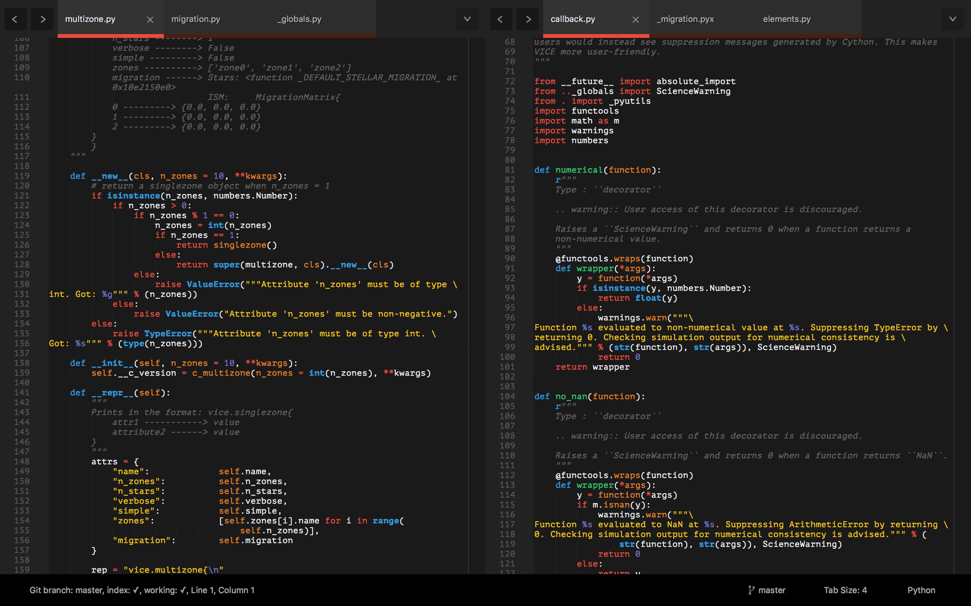
Tools: A Text Editor
Differs from an Integrated Development Environment (IDE) in that IDEs will run the code – all they do is open, create, edit, etc. plain text files
pycharm, spyder
I recommend Sublime Text
https://www.sublimetext.com/
Notes:
As mentioned before, a text editor is a useful tool when coding with Python as not everything can be done in notebooks. If you’ve ever written a file that ends in .py, that’s a python text file while notebooks typically end in .ipynb. IDE’s differ from notebooks in that they will run your code for you while notebooks are applications that use the internet to run your code for you. IDE’s are a type of text editor, but are also only dedicated to one language, meaning you can only code in Python in a Python IDE, such as PyCharm or Spyder. Whereas with other text editors, you can use multiple languages. Sublime Text is a great text editor that’s not an IDE, meaning you can code in many different languages. Ultimately, it’s up to you and what you feel like is the best fit for your needs as a researcher/programmer.

Slide 13
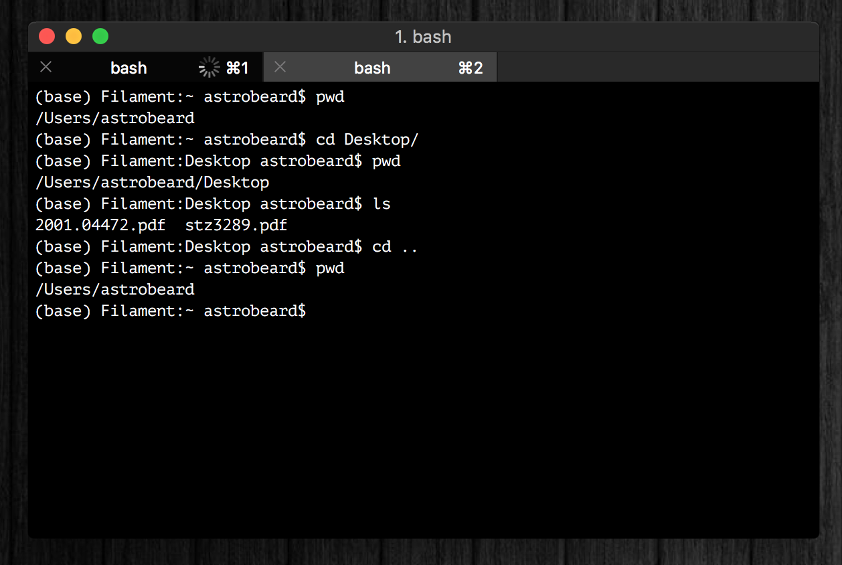
Tools: A Terminal
I recommand iTerm2
Terminal replacement
https://www.iterm2.com/
You should think of a terminal as just a different interface on a Finder window with some extra programs built-in
Tip: you can run python line-by-line in a terminal (python or ipython)
Notes:
Works the same as a Finder window basically, if you have a Mac you have a built in terminal application. iTerm2 is an application that can replace your terminal and functions just the same. Terminals are also cool because you run python code line by line in them, so if you wanted to import or update already installed Python packages or libraries, you can do it right there instead of in your notebook or text editor.

Slide 14
Tools: A Terminal
If you’re running Windows, your terminal will be different than some of the notes and exercises here, unless you take some extra steps at the beginning to set up a bash interpreter.
Talk to me if you need help with this!
Notes:
For Windows users, those who don’t have a Mac or Linux machine, terminal can be a bit more difficult to find and use but it is possible. There’s a couple extra steps that you have to do get it so be sure to come and talk to us if you want/need help with getting that set up on your Windows machine.

Slide 15
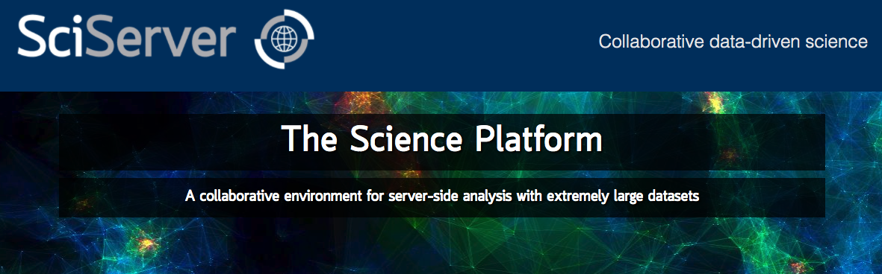
Tools: Cloud Computing
Allows you to run python on a remote server
SciServer is a popular platform across many STEM fields:
https://www.sciserver.org/
In the long run you should choose the tools that you’re most comfortable with
Notes:
We won’t be using this in the bootcamp but is a good tool to use. It’s an example of a cloud-computing server, meaning that when you run a notebook on SciServer, instead of it being ran by your computer, it’s being ran by their own server. Basically, your computer is not doing the work and running the code, it’s the website (in this case SciServer’s) own remote server that is executing the code and then sending the results of that code back to you to look at. Again, use the application that you are most comfortable with!

Slide 16

If You Haven’t Already
https://www.anaconda.com/products/individual
This will install Python, Anaconda, and Jupyter Notebooks
Latest version of python: 3.10.4
Most libraries now require >= 3.7
NumPy’s latest version requires >= 3.8
Python 2.7 is deprecated
Notes:
If you haven’t already, you’ll need to get Python. We won’t be going over Python itself today, but this is just so you guys have some time to get familiar with the tools around programming and have time to download and install your platform of choice. If you don’t know if you have Python, go to this link and it will install Python, Anaconda and Jupyter Notebooks for you. I use Anaconda to get to Jupyter Notebooks and Spyder, so it’s kind of like a main menu of all the different ways you can run Python. We will talk more in depth about Anaconda and things you can do with it later in the bootcamp course. Python 2.7 and below are deprecated, which means the programmers who run Python do not offer support or code for any versions older than Python 2.7. So, again, this website will let you download Python if it’s not already installed and update it if your machine has it pre-installed with the latest version of Python which is 3.10.

Slide 17
Other Resources
Python Foundation’s Beginner’s Guide: https://www.python.org/about/gettingstarted/
https://www.learnpython.org/ - There is also an iOS app for this
Codecademy: https://www.codecademy.com/learn/learn-python-3
Notes:
Developed Python and a good start for a refresher or new to Python, 2) LearnPython is an app and website and a good way to learn syntax and get it running, 3) CodeAcademy is a great tool too, plenty of resources

Slide 18
Goals
What we’ll aim to cover:
How to use a terminal
Review of the basics: control structures, data types, functions, import, etc.
How to read documentation
How to import your own code, and how to set up a directory tree to organize it
Classes: how to make new objects
Inheritance and Composition
Some basic software engineering principles (i.e. good habits)
Notes:
Today, Wednesday, Friday (Anaconda too, documentation is important throughout different packages or libraries, going over exercises), Monday (second week is going more into detail about object-oriented programming, something we’ll talk a little bit about today), Wednesday (inheritance and composition are powerful tools), Thursday (not coding more, but coding better) Less is more!

Slide 19
Monday Motivation
Every expert coder was once a novice.
You can’t improve your coding practices without first criticizing what you once thought was great code.
Since we’re not professional developers, scientists have to actively create and foster good coding habits if they want them. Being early career researchers, you have the option to make this decision now. It will only become more difficult to do this.

